Slide 1
Assignment 1 OOP

Slide 2
Create an application that contains a method that computes the final price for a sales transaction and returns that value to a calling method. The method requires three arguments: product price, salesperson commission rate, and customer discount rate. A product’s final price is the original price plus the commission amount minus the discount amount;
Create a class named “Holiday” with 3 private instance variables (name, day, month). Write a parameterized constructor for the class Holiday, which takes 3 parameters as its arguments, and sets the class variables to these values. Write a method inSameMonth,
Create a class called Invoice with instance variables—a part number (String), a part description (String), a quantity of the item being purchased (int) and a price per item (double). Your class should have a parameterized constructor that initializes the four instance variables.
Create a class named “Movie” with 3 private String instance variables (title, Producer, rating). Write a parameterized constructor for the class Movie, which takes 3 parameters as its arguments, and sets the class variables to these values.

Slide 3
the customer discount is taken as a percentage of the total price after the sales person commission has been added to the original price. Write a main() method that prompts the user for the price of an item, the salesperson’s commission expressed as a percentage, and the customer discount expressed as a percentage, and that then passes the values to the method. [3M].
which compares two instances of the class Holiday, and returns the Boolean value true if they have the same month, and false if they do not. Write a driver class to create instances and demonstrate the methods of the above class. [3M].
Provide a set and a get method for each instance variable. In addition, provide a method named getInvoiceAmount that calculates the invoice amount (quantity * the price per item), then returns the amount as a double value. Write a test application named InvoiceTest that demonstrates class Invoice’s capabilities. [3M].
Write a method hitMovie, which checks the rating of the Movie instance, and returns the Boolean value true if the rating is from Four-Five, and false if its less than that. Write a driver class to create instances and demonstrate the methods of the above class. [3M].

Slide 4
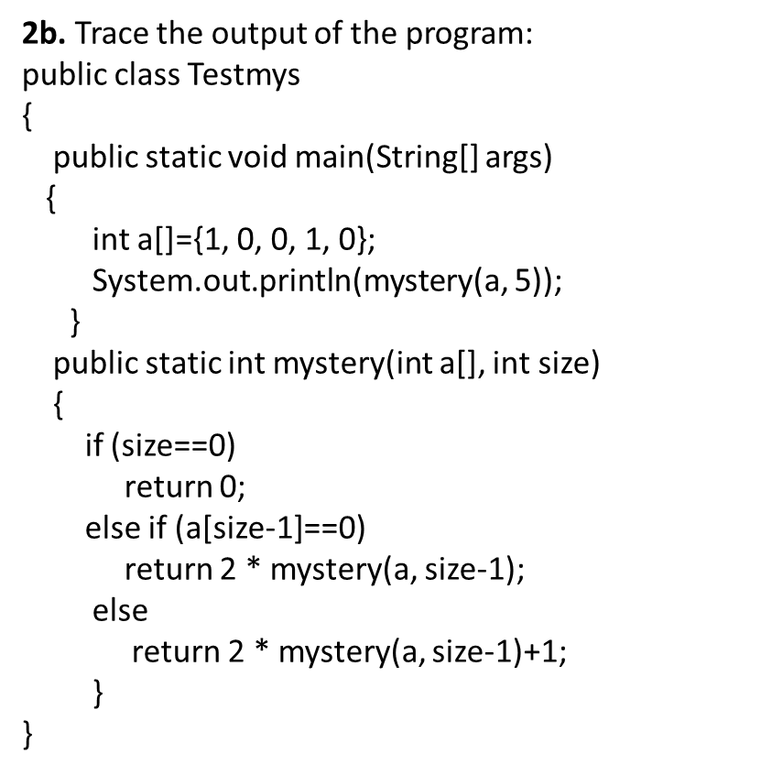
1b. Trace the output of the program:
public class Tester {
public static void main(String args[]) {
first:
for (int i = 0; i < 3; i++) {
for (int j = 0; j < 3; j++){
if(i == 1){ continue first; }
System.out.print(" [i = " + i + ", j = " + j + "] ");
}
}
System.out.println();
second:
for (int i = 0; i < 3; i++) {
for (int j = 0; j < 3; j++){
if(i == 1){ break second; }
System.out.print(" [i = " + i + ", j = " + j + "] ");
}
}
}
}

Slide 5
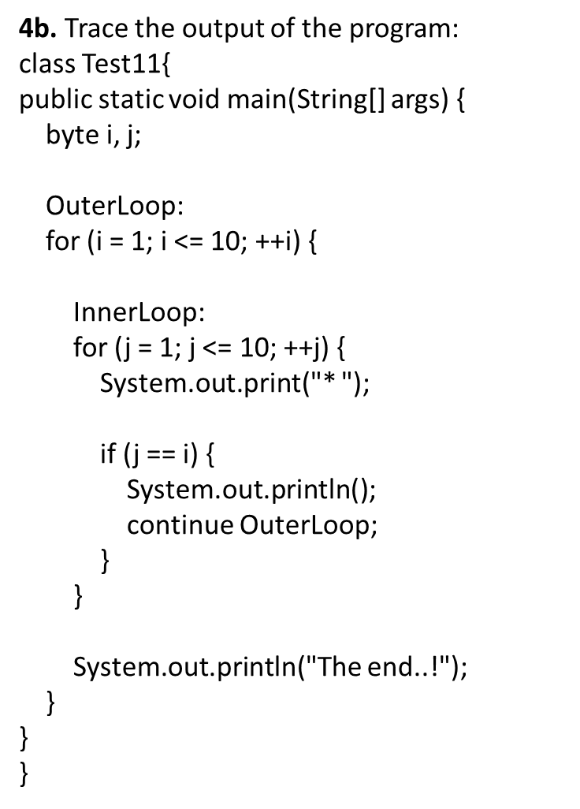
3b. Trace the output of the program:
public class Testmys{
public static void main(String[] args) {
int a[]= {24, 35, 67, 89, 102, 134, 167, 189, 209,
289, 354, 396, 425};
System.out.println(mystery(a, 13));
}
public static int mystery(int a[], int size) {
if (size ==1)
return a[0];
if (size ==2)
return (a[0]+a[1]) / 2;
int helper[] = new int[a.length- 2];
int k= 0;
for (int j= 1; j< size- 1; j++) {
helper[k] = a[j];
k++;
}
return mystery(helper,size -2);
}
}

